Slide 1

Financial Accounting
Dr. Smita Jape
Associate Professor,DR.V.N.BRIMS

Slide 2
LEARNING OBJECTIVES chapter 3
1. Explain, in simple terms, the generally accepted ways of solving the measurement issues of recognition, valuation, and classification.
2. Describe the chart of accounts and recognize commonly used accounts.
3. Define double-entry system and state the rules for double entry.

Slide 3
LEARNING OBJECTIVES (continued)
4. Apply the steps for transaction analysis and processing to simple transactions.
5. Prepare a trial balance and describe its value and limitations.

Slide 4
Supplemental Objectives
1. Record transactions in the general journal.
2. Post transactions from the general journal to the ledger.

Slide 5
Measurement Issues
OBJECTIVE 1
Explain, in simple terms, the generally accepted ways of solving the measurement issues of recognition, valuation, and classification.

Slide 6
Measurement Issues
Business transactions are economic events that affect the financial position of a business entity.
To measure a transaction an accountant must decide:
1. When did the transaction occur?
2. What value should be placed on the
transaction?
3. How should the components of the
transaction be categorized?
Even though GAAP are followed, controversy
does exist regarding these questions.

Slide 7
The Recognition Issue
Recognition refers to the difficulty of deciding when a business transaction should be recorded.
The recognition point (RP) is the time determined for recording a transaction.
EXAMPLE: A company orders, receives, and pays for an office desk.
  Traditionally, the transaction is recorded when the title transfers.
  In a small business, the RP could be when the bill is received or paid.
The recognition issue is not always solved easily.

Slide 8
The Valuation Issue
Perhaps the most controversial issue in accounting.
Valuation focuses on assigning a monetary value to a business transaction.
GAAP requires the use of historical cost.
  Cost is defined as the exchange price associated with a business transaction at the point of recognition.
  Purpose of accounting is to account for value in terms of cost, not in terms of value, which can change over time.
  Value means the cost at the time of the transaction.

Slide 9
The Cost Principle
The cost principle is the practice of recording transactions at cost.
The market value of an asset may change over the years, but its recorded cost remains in the accounting records.
The market value is the result of the actions of independent buyers and sellers who agree on a price.
The cost principle is used because the cost is verifiable.

Slide 10
The Classification Issue
Classification is assigning all the transactions in which a business engages to appropriate categories or accounts.
Proper classification depends on:
  1. Correctly analyzing the effect of each transaction
  on the business, and
  2. Maintaining a system of accounts
  that reflects that effect.

Slide 11
Accounts
Businesspeople need to be able to retrieve transaction data quickly and in usable form.
A filing system consisting of accounts is used to sort out or classify all the transactions that occur in a business.
Accounts are the basic storage unit for accounting data and are used to accumulate amounts from similar transactions.

Slide 12
An accounting system has a separate account for each asset, liability, and each component of stockholders’ equity, including revenues and expenses.
A small organization may have only a few dozen accounts; a multinational corporation may require thousands of accounts.
The group of company accounts is known as the general ledger or simply ledger.
The general ledger may be manual or computer-based.

Slide 13
The Chart of Accounts
Accounts are numbered to make them easy to find.
The list of all account numbers and names is known as the chart of accounts.
Accounts are numbered for processing and reference purposes.
  The account number may be coded to provide information about the account.
  An asset account typically starts with 1.
  A liability account typically starts with 2.

Slide 14
Stockholders’ Equity Accounts
Stockholders’ equity accounts represent legal
claims by stockholders against the assets of
the company.
Common Stock represents stockholders’ claims arising from their investments in the company.
Retained Earnings (R/E) represents stockholders’ claims arising from profitable operations.
R/E do not represent pools of assets that have been put aside, but claims against the general assets of the company.
Dividends are included because they are a distribution of assets that reduce ownership claims.

Slide 15
The law requires that capital investments and dividends be separated from revenues and expenses for income tax reporting, financial reporting, and other purposes.
Management needs a detailed breakdown of revenues and expenses for budgeting and operating purposes.
Accounting gives management information about whether it has achieved its primary goal of earning a net income.

Slide 16
Account Titles
The title should describe what is recorded in the account.
If an account title is not recognizable, examine the context of the name.
  Determine if it is an asset, liability, stockholders’ equity, revenue, or expense.
  Look for the kind of transaction that gave rise to the account.

Slide 17
The Double-Entry System
Evolved during the Renaissance.
Described by
Fra Luca Pacioli,
Italy, 1494.

Slide 18
Features of the
Double-Entry System
Principle of duality.
Each transaction must be recorded with at least one debit and one credit so that monetary value of debits and credits are equal.
The whole system is always in balance.
All accounting systems are based on the principle of duality.

Slide 19
The T Account
Title of Account
Debit
(left) side
Credit
(right) side

Slide 20
The T Account Illustrated
Cash
(1) 50,000 (2) 35,000
(5) 1,500 (4) 200
(7) 1,000 (8) 1,000
(9) 400
(11) 600
52,500 37,200
Bal. 15,300
Footings, the total of each side are computed.
The difference between the debit side and the credit side is the account’s balance, either debit or credit.

Slide 21
Analyzing and Processing Transactions
Every transaction affects at least two accounts.
Total debits must equal total credits.
Assets = Liabilities + Stockholders’ Equity.
Assets = Liabilities + S/E
Debit
for
increases
(+)
Credit
for
decreases
(-)
Debit
for
decreases
(-)
Credit
for
increases
(+)
Debit
for
decreases
(-)
Credit
for
increases
(+)

Slide 22
Application of Debit/Credit
Rules to S/E
Assets = Liabilities
+ Common Stock
+ Retained Earnings
- Dividends
+ Revenues
- Expenses
Debit is commonly abbreviated Dr.
Credit is commonly abbreviated Cr.

Slide 23
Arrangement of the Accounting Equation
The accounting equation can be rearranged to shift dividends and expenses to the left side.
Assets + Dividends + Expenses
=
Liabilities + Common Stock + Retained Earnings + Revenues

Slide 24
Steps in Analyzing and Processing Transactions
1. Analyze the transaction to determine its effect on assets, liabilities, and S/E.
- Supported by a source document.
2. Apply the rules of double entry.
- Dr. increases an asset.
- Cr. Increases a liability.

Slide 25
Steps in Analyzing and Processing Transactions (continued)
3. Record the entry.
  Enter in chronological order in a journal.
  Enter the date/debit account/debit amount on one line.
  Enter the credit account/credit amount indented on the next line.
        Dr. Cr.
  June 1 Cash 100,000
  Notes Payable 100,000
This form is called journal form and usually is followed by an explanation.

Slide 26
Steps in Analyzing and Processing Transactions (continued)
4. Post the entry.
  Post the entry to the general ledger by transferring the date and amount to the proper account.
5. Prepare the trial balance to confirm the balance of the accounts.
  Confirm that the accounts are still in balance after recording and posting transactions.

Slide 27
Mr X begins business.
Dr. Cr.
Jan. 1 Cash 10,000
Capital account 10,000
Cash
Transaction
Analysis
Rules
Entry
Jan. 1 10,000
Capital account
Jan. 1 10,000

Slide 28
pays Rs800 rent .
Dr. Cr.
Jan. 2 Rent 800
Cash 800
Cash
Transaction
Analysis
Rules
Entry
Jan. 1 10,000
Jan 2. 800
Rent Account
Jan. 2 800

Slide 29
Purchases equipment, Rs4,200, with cash.
Dr. Cr.
Jan. 4 Equipment 4,200
Cash 4,200
Cash
Transaction
Analysis
Rules
Entry
Jan. 1 10,000
Jan. 2 800
4 4,200
Equipment
Jan. 4 4,200

Slide 30
Purchases office equipment, Rs3,000, pays Rs1,500 in cash and agrees to pay the rest next month.
Dr. Cr.
Jan. 5 Office Equipment 3,000
Cash 1,500
Accounts Payable 1,500
Cash
Transaction
Analysis
Rules
Entry
Jan. 1 10,000
Jan. 2 800
4 4,200
5 1,500
Office Equipment
Jan. 5 3,000
Accounts Payable
Jan. 5 1,500

Slide 31
Purchases Stationary Rs1,800, and office supplies, Rs800, on credit.
Dr. Cr.
Jan. 6 Stationary 1,800
Office Supplies 800
Accounts Payable 2,600
Stationary
Transaction
Analysis
Rules
Entry
Jan. 6 1,800
Office Supplies
Jan. 6 800
Accounts Payable
Jan. 5 1,500
6 2,600

Slide 32
Pays insurance policy with cash.
Dr. Cr.
Jan. 8 Insurance expenses 480
Cash 480
Cash
Transaction
Analysis
Rules
Entry
Jan. 1 10,000
Jan. 2 800
4 4,200
5 1,500
8 480
Insurance
Jan. 8 480

Slide 33
Pays Rs1,000 of amount owed to Mr Y and Co.
Dr. Cr.
Jan. 9 Accounts Payable 1,000
Cash 1,000
Cash
Transaction
Analysis
Rules
Entry
Jan. 1 10,000
Jan. 2 800
4 4,200
5 1,500
8 480
9 1,000
Accounts Payable
Jan. 9 1,000
Jan. 5 1,500
6 2,600

Slide 34
Collects a fee of Rs1,400 for placing advertisements.
Dr. Cr.
Jan. 10 Cash 1,400
Advertising Fees Earned 1,400
Cash
Transaction
Analysis
Rules
Entry
Jan. 1 10,000
10 1,400
Jan. 2 800
4 4,200
5 1,500
8 480
9 1,000
Advertising Fees Earned
Jan. 10 1,400

Slide 35
Pays worker two weeks’ wages, Rs600.
Dr. Cr.
Jan. 12 Wages Expense 600
Cash 600
Cash
Transaction
Analysis
Rules
Entry
Jan. 1 10,000
10 1,400
Jan. 2 800
4 4,200
5 1,500
8 480
9 1,000
12 600
Wages Expense
Jan. 12 600

Slide 36
Accepts Rs1,000 for IT work to be done for another agency.
Dr. Cr.
Jan. 15 Cash 1,000
Unearned IT Fees 1,000
Cash
Transaction
Analysis
Rules
Entry
Jan. 1 10,000
10 1,400
15 1,000
Jan. 2 800
4 4,200
5 1,500
8 480
9 1,000
12 600
Unearned IT
Jan. 15 1,000

Slide 37
Performs a service for Rs2,800. FeeS to be collected next month.
Dr. Cr.
Jan. 19 Accounts Receivable 2,800
Advertising Fees Earned 2,800
Accounts Receivable
Transaction
Analysis
Rules
Entry
Jan. 19 2,800
Advertising Fees Earned
Jan. 10 1,400
19 2,800

Slide 38
Pays the worker two more weeks’ wages, Rs600.
Dr. Cr.
Jan. 26 Wages Expense 600
Cash 600
Cash
Transaction
Analysis
Rules
Entry
Jan. 1 10,000
10 1,400
15 1,000
Jan. 2 800
4 4,200
5 1,500
8 480
9 1,000
12 600
26 600
Wages Expense
Jan. 12 600
26 600

Slide 39
Receives and pays the utility bill, Rs100.
Dr. Cr.
Jan. 29 Utilities Expense 100
Cash 100
Cash
Transaction
Analysis
Rules
Entry
Jan. 1 10,000
10 1,400
15 1,000
Jan. 2 800
4 4,200
5 1,500
8 480
9 1,000
12 600
26 600
29 100
Utilities Expense
Jan. 29 100

Slide 40
telephone bill paid , Rs70.
Dr. Cr.
Jan. 30 Telephone Expense 70
Cash accounts 70
Telephone Expense
Transaction
Analysis
Rules
Entry
Jan. 30 70
Cash account
Jan. 9 1,000
Jan. 5 1,500
6 2,600
30 70

Slide 41
Declared and paid a dividend of Rs1,400.
Dr. Cr.
Jan. 31 Dividends 1,400
Cash 1,400
Cash
Transaction
Analysis
Rules
Entry
Jan. 1 10,000
10 1,400
15 1,000
Jan. 2 800
4 4,200
5 1,500
8 480
9 1,000
12 600
26 600
29 100
31 1,400
Dividends
Jan. 31 1,400

Slide 42
The Trial Balance
The total of debits and credits in the accounts must be equal.
A trial balance is prepared periodically (usually on the last day of the month) to test this equality.
Steps in preparing a trial balance:
  1. List each ledger account that has a balance, debit balances in the right column, credit balances in the left column.
  2. Add (foot) each column.
  3. Compare the totals of the two columns.

Slide 43
An account may have a balance other than its normal balance.
  An asset account may have a credit balance.
  A liability account may have a debit balance.
The trial balance proves whether or not the total of all debits recorded equals the total of all credits recorded.
It does not prove that the transactions were analyzed correctly or recorded for the correct amounts or in the proper accounts.

Slide 44
On April 01, 2016 Anees started business with Rs. 100,000 and other transactions for the month are:
2. Purchase Furniture for Cash Rs. 7,000.
8. Purchase Goods for Cash Rs. 2,000 and for Credit Rs. 1,000 from Khalid Retail Store.
14. Sold Goods to Khan Brothers Rs. 12,000 and Cash Sales Rs. 5,000.

Slide 45
18. Owner withdrew of worth Rs. 2,000 for personal use.
22. Paid Khalid Retail Store Rs. 500.
26. Received Rs. 10,000 from Khan Brothers.
30. Paid Salaries Expense Rs. 2,000

Slide 46
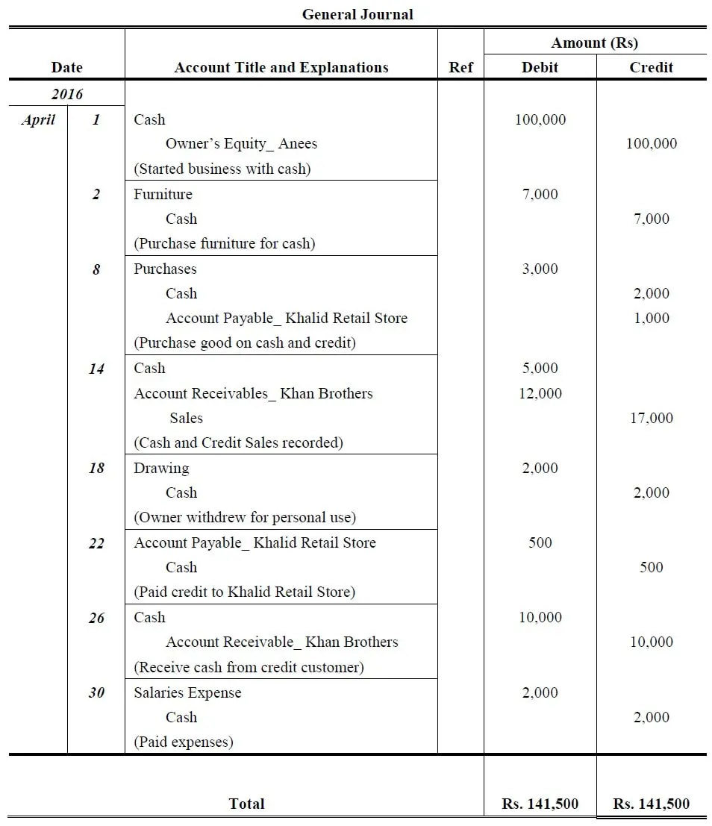

Slide 47
Aug. 1: Hashim Khan, the owner, invested Rs. 57,500 cash and Rs. 32,500 of photography equipment in the business.
04: Paid Rs. 3,000 cash for an insurance policy covering the next 24 months.
07: Services are performed and clients are billed for Rs. 10,000.
13: Purchased office supplies for Rs. 1,400. Cash paid Rs. 400 and remaining outstanding.

Slide 48
20: Received Rs. 2,000 cash in photography fees earned previously.
24: The client immediately pays Rs. 15,000 for services to be performed at a later date.
29: The business acquires photography equipment. The purchase price is Rs. 100,000, pays Rs. 25,000 cash and signs a note for the balance.

Slide 49
